Slide 1
Project:
Microsoft : Classifying Cybersecurity Incidents with Machine Learning

Slide 2
Domain: Cybersecurity
Cybersecurity focuses on protecting systems, networks, and data from digital attacks, unauthorized access, and damage. It involves implementing measures like firewalls, encryption, and intrusion detection to ensure data integrity and confidentiality.

Slide 3
Project Introduction:
This project aims to enhance the operational efficiency of Security Operation Centers (SOCs) by developing a machine learning model that accurately classifies cybersecurity incidents as true positive, benign positive, or false positive. Using the GUIDE dataset, the model leverages historical incident data and customer responses to support automated triage, enabling SOC analysts to focus on critical threats and respond faster to potential security issues, ultimately strengthening enterprise security.

Slide 4
Objective of the project:
Developed a machine learning model to classify cybersecurity incidents into true positive, benign positive, or false positive categories, enhancing SOC efficiency by automating triage grading. This solution aids SOCs, incident response automation, threat intelligence, and enterprise security by prioritizing threats, reducing false positives, and speeding up response times.

Slide 5
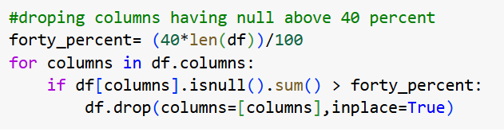
Data Preprocessing:
Removing the columns with null values above forty percentage will prevent biasing the prediction because imputing this will lead to that case.

Slide 6
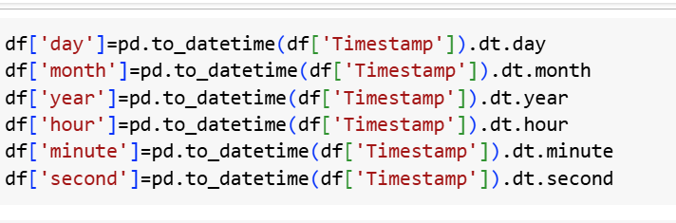
After removing those columns the only left out is the target column “IncidentGrade”. So, the null values are dropped .
Next creating new columns from Timestamp columns to support the target prediction.

Slide 7
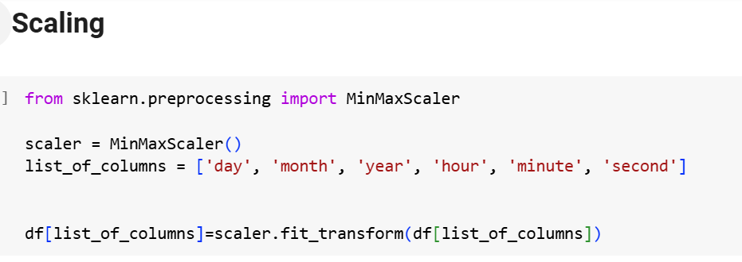

Slide 8
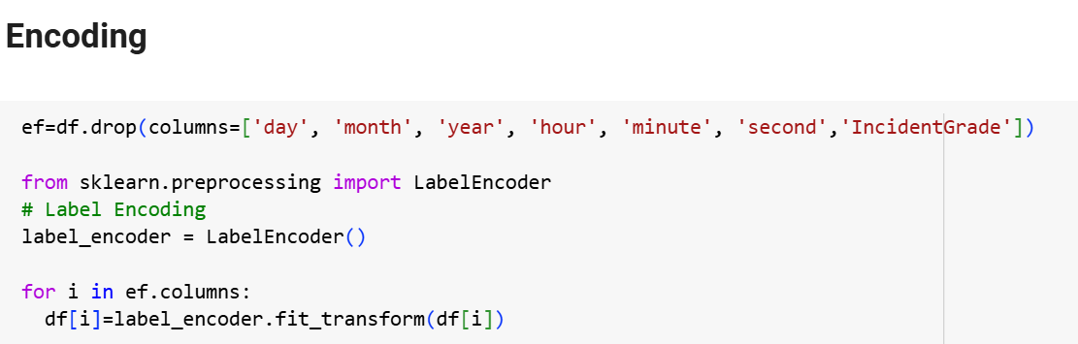

Slide 9
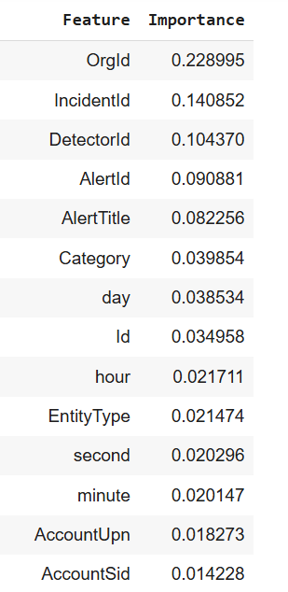
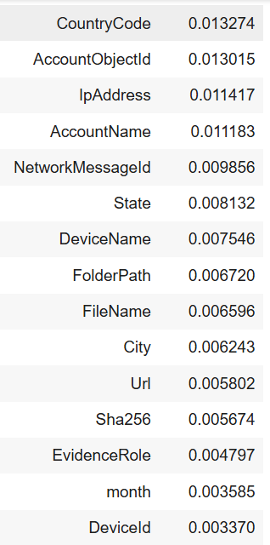
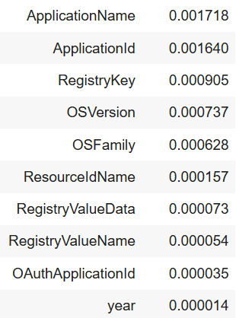
Feature Engineering:
Using random forest for feature engineering

Slide 10
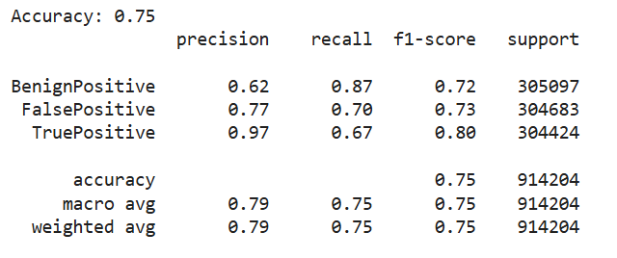
Since all the features are having importance including the created ones. Model building is done with all the columns.
Decision tree

Slide 11
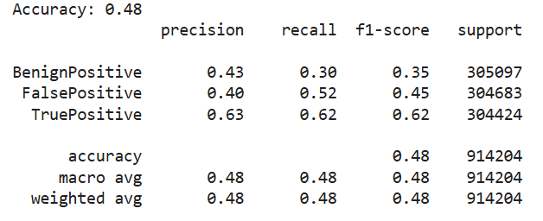
Logistic Regression

Slide 12
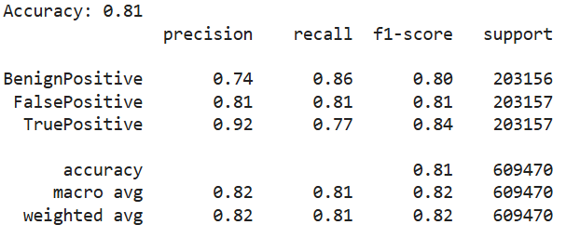
Gradient boosting
Even though accuracy here is same as random forest, the test accuracy is low

Slide 13
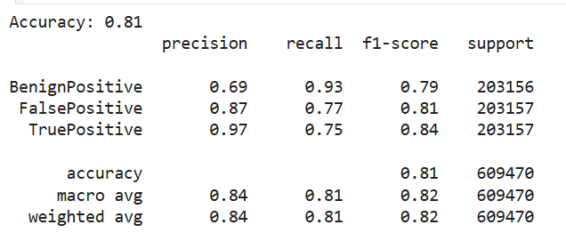
Random Forest

Slide 14
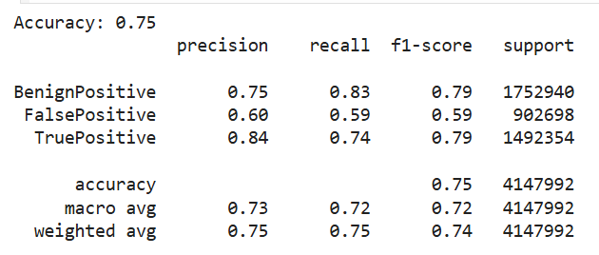
Random Forest Test
Since random forest gives best accuracy, it was chosen as the best model.

